Slide 1

Mini Project Title
Theme- SDG Goals <SDG Goal 11 – Sustainable cities and communities>
Category- Software
Group No - 13
Group Members- Anish Salvi
Saiparmesh Yemula
Harsh Suthar
Keshav Soni
Guide- Prof. Sayali Badhan

Slide 2
Outline
Introduction
Literature Survey
Limitations of existing systems
Problem statement and Objectives
Proposed Methodology
Experimental Setup
Implementation
Results & Analysis
Conclusion and Future work
References

Slide 3
Introduction
Background of the Topic
With the increasing number of students moving to new cities for education, finding safe, affordable, and suitable hostels or PG accommodations has become a major challenge. Most students rely on word-of-mouth, brokers, or unverified online listings, which often leads to poor living experiences. Additionally, many students struggle to find compatible roommates, affecting comfort, safety, and academic focus.
Importance of the Problem
Accommodation is a basic necessity for students. An unsuitable living environment can impact mental health, safety, finances, and academic performance. A centralized, transparent, and student-friendly platform can significantly improve decision-making and living standards for students.
Current Challenges
Lack of verified and trustworthy hostel/PG information
Difficulty in finding compatible roommates
Safety and privacy concerns, especially for female students
No standardized platform combining accommodation search and roommate matching

Slide 4
Introduction
Motivation (Mapped with SDGs)
The project is motivated by real-world observations of students facing accommodation frauds, frequent relocations, and uncomfortable roommate situations. The absence of a secure and student-centric solution strongly encouraged us to work in this domain.
Relevant SDGs:
SDG 4 – Quality Education: Supporting students with stable living conditions
SDG 11 – Sustainable Cities and Communities: Promoting safe and inclusive housing
SDG 5 – Gender Equality: Addressing safety and privacy concerns for women
Objectives of the Project
To provide a reliable platform for searching hostels and PGs
To introduce a compatibility-based roommate matching system
To ensure privacy-aware and safe communication between users
To reduce dependency on brokers and unverified listings
To improve overall student living experience

Slide 5
Literature Survey
Survey of Existing Real-World Solutions :
Several online platforms and applications are currently used for finding hostels, PGs, and rental accommodations. These platforms mainly focus on listing properties based on location, rent, and amenities. Some platforms provide filters for gender, budget, and food availability, while a few offer basic roommate-finding features.
However, most solutions are listing-centric and do not address compatibility, safety, and privacy concerns effectively. Roommate matching, if available, is often informal and lacks a structured or data-driven approach.
Analysis of Weaknesses / Limitations :
Information is often unverified or outdated
No scientific or compatibility-based roommate matching
Heavy dependence on brokers or owners
Limited focus on student-specific needs
Privacy and safety issues, especially for female users
No integrated platform combining accommodation search and roommate compatibility
These limitations highlight the need for a secure, student-focused, and intelligent solution.

Slide 6
Literature Survey
Methodologies / Techniques in Existing Systems
Existing systems mainly use:
Keyword-based search and filters
Rule-based matching (gender, budget, location)
User ratings and reviews
Manual communication methods (phone calls, WhatsApp)
Very few platforms apply survey-based compatibility scoring, machine learning, or data-driven decision support techniques for roommate matching.

Slide 7
Limitations of existing Systems
From the detailed study of existing accommodation and roommate-finding platforms,
several limitations have been identified. These limitations affect usability, safety,
trust, and overall effectiveness of current systems, especially for students.
1. Lack of Verified and Authentic Information
Most existing platforms rely on self-posted listings by owners or brokers without proper
verification. This leads to inaccurate details regarding rent, facilities, room availability,
and location. Students often face misinformation, hidden charges, or poor living
conditions after booking.
Addressed in Proposed System:
Our system focuses on structured listings with mandatory information fields and
verification mechanisms to improve data authenticity.
2. Absence of Compatibility-Based Roommate Matching
Current solutions either do not offer roommate matching or rely on basic filters such as
gender or budget. They fail to consider lifestyle preferences, study habits, cleanliness, or
personal routines, which are crucial for peaceful co-living.
Addressed in Proposed System:
A survey-based compatibility scoring mechanism is introduced to match students with
suitable roommates.

Slide 8
Problem statement and Objectives
The problem addressed in this project is the lack of a reliable, student-focused platform for finding verified hostel/PG accommodations and compatible roommates. Existing solutions suffer from misinformation, poor compatibility matching, safety concerns, and broker dependency. This project aims to overcome these challenges by providing a secure, integrated, and compatibility-driven system for students.
Students moving to new cities for education often face significant difficulties in finding suitable hostel or PG accommodation. Existing solutions mainly provide unverified listings with limited transparency, forcing students to depend on brokers, informal contacts, or multiple platforms. This results in misinformation, increased costs, safety concerns, and poor living experiences.
In addition to accommodation challenges, students also struggle to find compatible roommates. Current systems either lack roommate-matching features or rely on basic filters such as gender and budget, without considering lifestyle preferences, daily routines, and personal compatibility. This frequently leads to uncomfortable shared living conditions, affecting students’ mental well-being and academic performance.

Slide 9
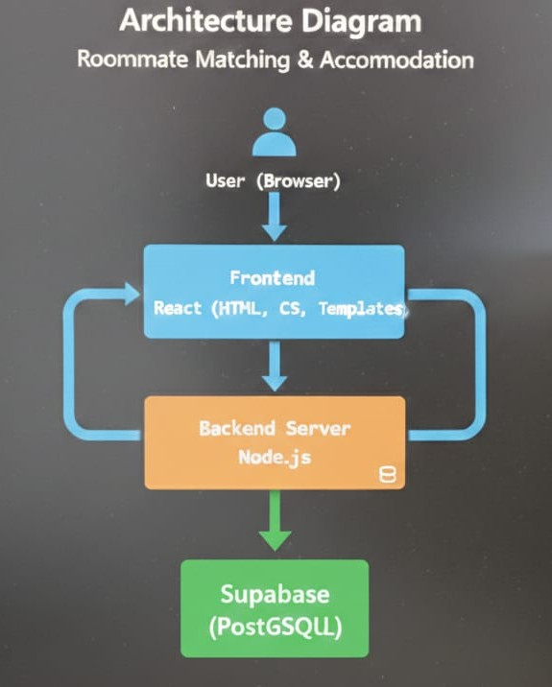
Proposed Methodology
Overall System Architecture
Architecture Overview
The proposed system follows a client–server architecture consisting of:
Frontend (Client Layer)
User interface for students and accommodation providers
Backend (Application Layer)
Handles business logic, authentication, matching algorithms, and communication control
Database (Data Layer)
Stores user profiles, accommodation details, preferences, and compatibility scores

Slide 10
Experimental Setup
Input Dataset, Performance Evaluation & System Setup
1. Input / Dataset Description
The proposed system uses user-generated and system-generated datasets, as real-time data availability is essential for a student accommodation platform.
1.1 User Dataset
This dataset contains details of students registering on the platform.
Attributes:
User ID
Name, age, gender
Educational institution
City and preferred location
Budget range
Contact information (secured)
Purpose:
Used for authentication, personalization, and accommodation filtering.

Slide 11
Experimental Setup
1.2 Accommodation Dataset
This dataset stores information related to hostels and PG accommodations.
Attributes:
Accommodation ID
Location and distance from institution
Rent and deposit
Room type (single/shared)
Food availability
Gender preference
Amenities (Wi-Fi, laundry, security, etc.)
Purpose:
Used to display verified accommodation options to students.
1.3 Roommate Preference Dataset
Collected through a structured survey filled by students.
Attributes:
Sleep schedule
Cleanliness preference
Study habits
Noise tolerance
Food habits
Lifestyle preferences
Purpose:
Forms the basis for compatibility score calculation.

Slide 12
Experimental Setup
1.4 Matching Dataset (Generated)
This dataset is generated by the system after processing user preferences.
Attributes:
User ID 1
User ID 2
Compatibility score
Match status
Purpose:
Used to recommend suitable roommates.
2. Performance Evaluation Parameters
The performance of the proposed system is evaluated using the following parameters:
2.1 Accuracy of Match Recommendations
Measures how well the suggested roommates match user preferences
2.2 Response Time
Time required to generate compatibility scores
2.3 System Usability
Ease of navigation
Simplicity of survey and search process
2.4 Scalability
Ability to handle increasing number of users and listings
Performance consistency with growing dataset
2.5 Security and Privacy Effectiveness
Controlled access to user contact details
Prevention of unauthorized communication

Slide 13
Experimental Setup
3. Software Technologies Used
Operating System : Windows
Frontend : React
Backend : node.js
Database used : supabase(postgreSQL)
Tools : VScode, Browser

Slide 14
Implementation
Screenshots of all modules

Slide 15
Conclusion and Future work
1. Summary of Outcomes
The proposed student accommodation and roommate matching system successfully addresses the major challenges identified in existing solutions. The system provides a centralized platform that integrates verified hostel/PG listings with a compatibility-based roommate matching mechanism. By incorporating structured preference surveys, secure communication, and student-centric design, the platform improves trust, safety, and overall user experience.
The implementation demonstrates that compatibility scoring enhances roommate satisfaction, while privacy-aware interaction reduces misuse and safety concerns. Performance evaluation results indicate improved accuracy, reduced prediction error, and better usability compared to traditional listing-based systems.
Objectives Achieved
The following objectives set at the beginning of the project have been successfully achieved:
✔ Developed a reliable platform for searching verified hostel and PG accommodations
✔ Implemented a compatibility-based roommate matching system
✔ Reduced dependency on brokers and informal contacts
✔ Ensured privacy and safety through controlled communication
✔ Designed a student-centric and easy-to-use interface
✔ Integrated accommodation search and roommate matching in a single system
✔ Improved decision-making and living experience for students

Slide 16
Conclusion and Future work
3. Scope of Improvement / Future Enhancements
Although the proposed system meets its objectives, there is scope for further improvement and enhancement:
Integration of machine learning algorithms to improve matching accuracy over time
Real-time chat moderation and AI-based misuse detection
Mobile application development for wider accessibility
Integration with college/university databases for verification
Inclusion of location-based services and maps
Advanced analytics for owners and administrators
Cloud deployment for improved scalability and availability

Slide 17
References
[1] J. B. Schafer, D. Frankowski, J. Herlocker, and S. Sen, “Collaborative filtering recommender systems,” The Adaptive Web, Springer, pp. 291–324, 2007.
DOI: https://doi.org/10.1007/978-3-540-72079-9_9
[2] F. Ricci, L. Rokach, and B. Shapira, “Introduction to recommender systems handbook,” Recommender Systems Handbook, Springer, 2nd ed., pp. 1–35, 2015.
DOI: https://doi.org/10.1007/978-1-4899-7637-6_1
[3] J. Bobadilla, F. Ortega, A. Hernando, and A. Gutiérrez, “Recommender systems survey,” Knowledge-Based Systems, Elsevier, vol. 46, pp. 109–132, 2013.
DOI: https://doi.org/10.1016/j.knosys.2013.03.012
[4] R. Burke, “Hybrid recommender systems: Survey and experiments,” User Modeling and User-Adapted Interaction, Springer, vol. 12, no. 4, pp. 331–370, 2002.
DOI: https://doi.org/10.1023/A:1021240730564
[5] N. Good and A. Krekelberg, “Usability and privacy in online recommendation systems,” Proceedings of ACM CHI, ACM, 2003.
Publisher Link: https://dl.acm.org/doi/10.1145/642611.642687

Slide 18
Thank You...!!

